Slide 1
On
Customer Churn Prediction Using Machine Learning
Project Based Learning
By
BANOTHU VASU 24X01A1209
Under the guidance of
G.LACHIRAM
Associate Professor
Department of Information Technology
Narsimha Reddy Engineering College (UGC- Autonomous)
(Approved by AICTE, Affiliated to JNTUH, Accredited by NBA & NAAC with A-Grade)
Maisammaguda (V), Kompally, Secunderabad, Telangana-500100.
2026-2027

Slide 2

OUTLINE
Abstract – (1 Slide)
Introduction – (1 Slide)
Literature Survey – (1 Slide)
Existing System – (1 Slide)
Limitations of Existing System – (1 Slide)
Proposed System – (1 Slide)
System Design & Architecture – (1 Slide)
Timelines – (1 Slide)
Implementation – (1 Slide)
Deployment and Testing – (1 Slide)
Result Analysis – (1 Slide)
Conclusion – (1 Slide)
References – (1 Slide)

Slide 3
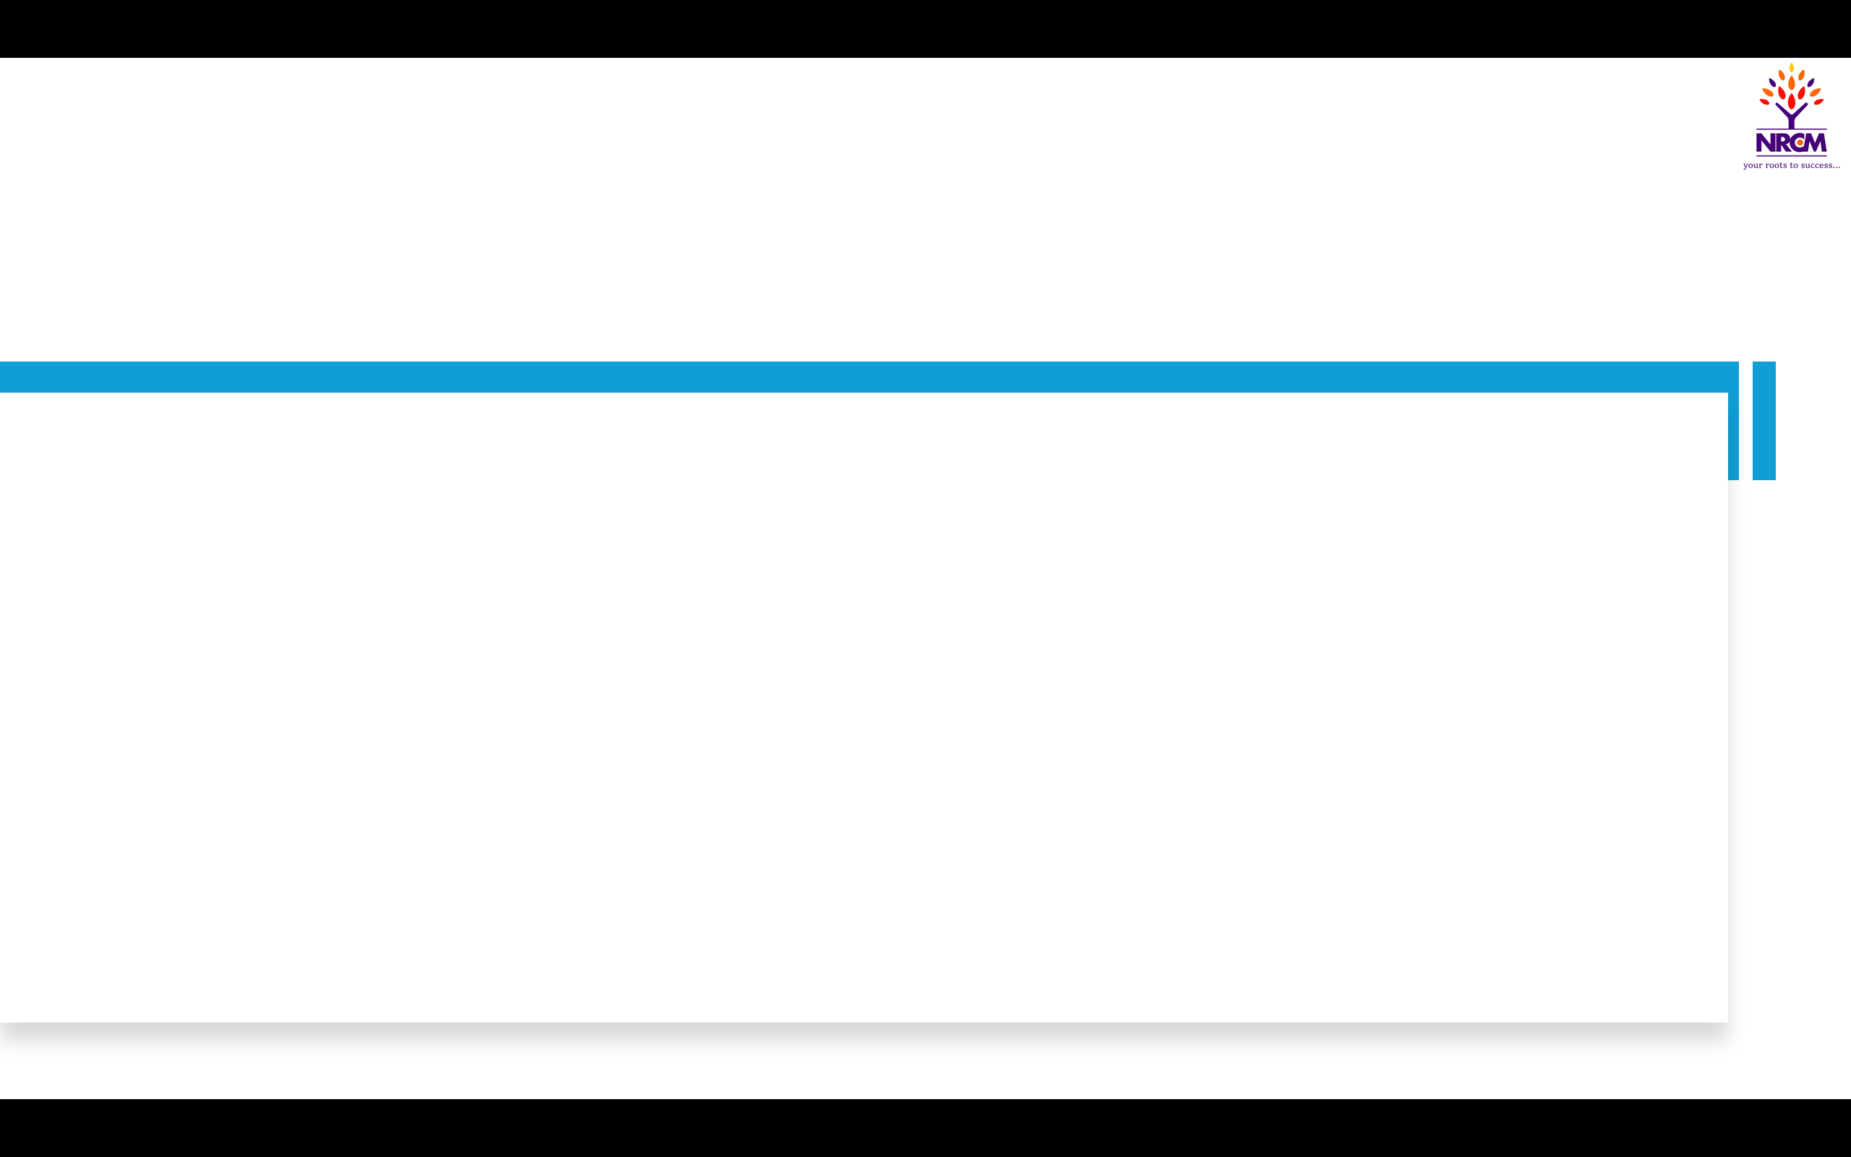
Abstract
Abstract
Customer churn (customers leaving a service) directly reduces revenue, and retaining a customer costs far less than acquiring a new one.
This project builds a machine learning model that predicts which customers are likely to churn.
Dataset: IBM Telco Customer Churn (7,043 customers, 20 features covering demographics, services, contract and billing).
Output: a churn probability per customer, enabling targeted retention offers.

Slide 4
Introduction
Introduction
Churn rate is a key performance indicator for subscription businesses such as telecom, banking, OTT .
Winning a new customer costs significantly more than keeping an existing one, so early detection of at-risk customers saves money.
Traditional retention is reactive: action is taken only after the customer has already left.
Objective: build, compare and interpret classification models to predict churn and identify its key drivers.

Slide 5
Literature Survey
Literature Survey
. benchmarked many classifiers on telecom churn data and showed profit-driven evaluation matters.
.Random Forests: ensembles of decision trees improve accuracy and reduce overfitting on tabular data..
. SMOTE: synthetic oversampling to handle the minority churn class.
. many studies stop at accuracy; this work adds recall-focused evaluation and feature-importance analysis.

Slide 6
Existing System
Existing System
Retention teams rely on manual reports, spreadsheets and fixed rules (for example, "no usage for 30 days").
Churn is noticed only after a cancellation or complaint; the same offer is sent to broad customer groups.
Basic statistical models are used without handling class imbalance or tuning.
Customer Activity & Billing Data
Manual Reports / Rule-Based Checks
Churn Noticed After Cancellation
Generic Retention Campaign

Slide 7
Limitations of Existing System
Limitations of Existing System
Reactive: action is taken after the customer has already left.
Limited insight: fixed rules cannot capture non-linear patterns across many features.
Wasted budget: generic offers reach loyal customers who would have stayed anyway.
No risk ranking: no churn probability per customer to prioritise the retention team.
Poor scalability: manual analysis does not scale as customer data grows.

Slide 8
Proposed System
Proposed System
An end-to-end ML pipeline that predicts a churn probability for every customer.
SMOTE balances churners and non-churners; GridSearchCV tunes each model's hyperparameters.
The best model is chosen on recall and ROC-AUC; feature importance explains the main churn drivers.
Customer Data
Pre-processing
Feature Selection
SMOTE Balancing
Model Training
Evaluation
Churn Score

Slide 9
System Design & Architecture
System Design & Architecture
Use case: user uploads customer data, system pre-processes it, predicts churn and shows the risk score with top drivers.
Architecture: data layer (CSV / SQL), ML layer (scikit-learn, XGBoost), application layer (Streamlit dashboard).
Requirements: Python 3.10, pandas, scikit-learn, XGBoost, matplotlib; 8 GB RAM and a standard CPU (no GPU needed).

Slide 10
Timelines
Timelines
Phase | Activity | Duration
1 | Problem definition and literature review | Weeks 1–2
2 | Data collection and exploratory analysis (EDA) | Weeks 3–4
3 | Pre-processing and feature engineering | Weeks 5–6
4 | Model building and hyperparameter tuning | Weeks 7–9
5 | Evaluation and dashboard development | Weeks 10–11
6 | Testing, documentation and final report | Week 12

Slide 11
Implementations
Data Collection & Storage
Customer Data Preprocessing
Environment: Python & Jupyter
Model Training & Evaluation
Coding: scikit-learn, XGBoost

Slide 12
Deployment & Testing
Deployment & Testing
Deployment environment setup: Python virtual environment; models trained in Jupyter, saved with joblib and served through a Streamlit app.
Testing with hold-out data: 80/20 stratified split plus 5-fold cross-validation on the Telco dataset.
Unit tests: checks for missing values, unseen categories and correct feature order in the pre-processing code.
Beta release: sample customer lists scored by a few users; feedback used to refine the dashboard.

Slide 13
Result Analysis
Result Analysis
XGBoost: best balance of recall and ROC-AUC.
Recall: prioritised, since a missed churner costs more than a false alarm.
Top drivers: month-to-month contract, short tenure, high monthly charges.
Illustrative values on the Telco dataset – replace with your own experiment results.

Slide 14
Conclusion
Conclusion
The ML approach identifies at-risk customers before they leave; XGBoost gave the best balance of recall and ROC-AUC against the Logistic Regression baseline.
Compared with the rule-based approach, churn scores enable targeted retention offers and lower campaign cost.
Future work: real-time data streams, deep learning on usage sequences, customer lifetime value and A/B testing of retention actions.

Slide 15
References
References
W. Verbeke, K. Dejaeger, D. Martens, J. Hur, B. Baesens, "New insights into churn prediction in the telecommunication sector," European Journal of Operational Research, 218(1), 2012.
L. Breiman, "Random Forests," Machine Learning, 45(1), 5–32, 2001.
T. Chen, C. Guestrin, "XGBoost: A Scalable Tree Boosting System," Proc. ACM SIGKDD, 2016.
N. V. Chawla et al., "SMOTE: Synthetic Minority Over-sampling Technique," JAIR, 16, 321–357, 2002.
F. Pedregosa et al., "Scikit-learn: Machine Learning in Python," JMLR, 12, 2825–2830, 2011.
IBM Telco Customer Churn dataset – kaggle.com/datasets/blastchar/telco-customer-churn

Slide 16
Any Queries

Slide 17
Thank You

